Slide 1
3GPP security architecture in 5G
DDragos

Slide 2
Short description of 3GPP
The 3rd Generation Partnership Project (3GPP) unites seven telecommunications standard development organizations (ARIB, ATIS, CCSA, ETSI, TSDSI, TTA, TTC), known as “Organizational Partners” and provides their members with a stable environment to produce the Reports and Specifications that define 3GPP technologies.¹
The project covers cellular telecommunications technologies, including radio access, core network and service capabilities, which provide a complete system description for mobile telecommunications.¹
The three Technical Specification Groups in 3GPP are;
-Radio Access Networks (RAN);
-Services & Systems Aspects (SA);
-Core Network & Terminals (CT) ;¹
Inside the group Services & Systems Aspects the TSG SA WG3 (SA3) takes care of defining the requirements and specifying the architectures and protocols for security and privacy but also the availability of cryptographic algorithms.¹
¹ https://www.3gpp.org/about-3gpp/about-3gpp

Slide 3
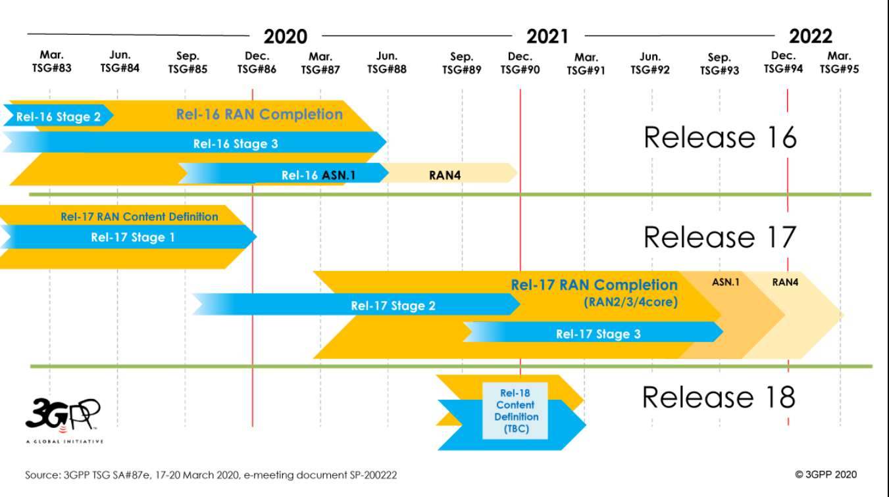
Release versions timeframe
Release 16 (5G phase 2) was completed in June 2020.
Release 17 is in development during 2021 and is expected to have the final version somewhere in June 2022.
Release 18 plan and requirements will be defined in the beginning of 2022.

Slide 4
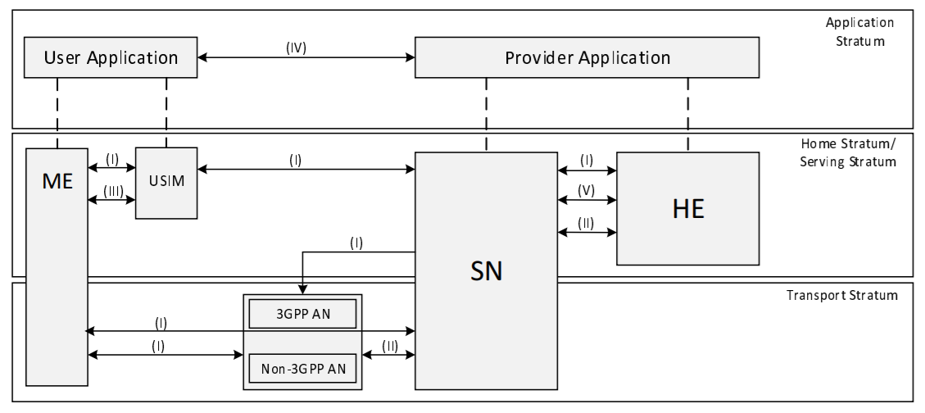
Overview of the security architecture
-Network access security (I):
enable a UE to authenticate and access services via the network securely
-Network domain security (II)
set of security features that enable network nodes to securely exchange signalling data and user plane data
-User domain security (III)
secures the user access to mobile equipment
-Application domain security (IV)
enable applications in the user domain and in the provider domain to exchange messages securely
- SBA domain security (V)
enables network functions of the SBA architecture to securely communicate within the serving network domain and with other network domains²
Security Architecture ²
² https://www.etsi.org/deliver/etsi_ts/133500_133599/133501/16.03.00_60/ts_133501v160300p.pdf

Slide 5
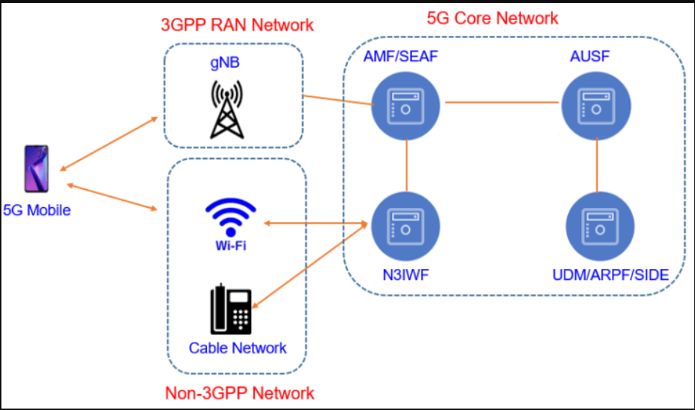
Network access with 5G-AKA OR EAP-AKA
Access and Mobility Management Function (AMF): It receives all connection and session responsible only for handling connection and mobility management tasks.
Security Anchor Function (SEAF): It resides within serving network (closely with AMF) and acts as “middleman” during the authentication process between a UE and its home network.
Authentication Server Function (AUSF): It is within a home network and performs authentication with a UE. It makes the decision on UE authentication, but it relies on backend for computing the authentication data and Keys when 5G-AKA or EAP-AKA’ is used.
Unified data management (UDM): Hosts functions related to data management, such as the Authentication Credential Repository and Processing Function (ARPF), which selects an authentication method based on subscriber identity and configured policy and computes the authentication data and Keys for the AUSF whenever required.
Non-3GPP Interworking Function (N3IWF): N3IWF acts as a VPN server to allow the UE to access the 5G core over untrusted, non-3GPP networks through IPsec tunnels. There can be multiple security contexts can be established with one authentication execution, allowing the UE to move from a 3GPP access network to a non-3GPP network without having to be reauthenticated.³
Network access security³
³https://www.techplayon.com/5g-authentication-and-key-management-aka-procedure/

Slide 6
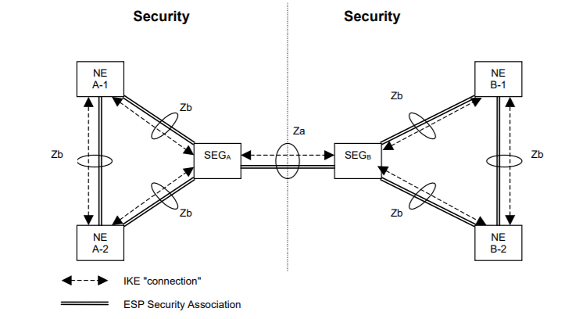
Network domain example
The basic idea to the NDS/IP architecture is to provide hop-by-hop security.
The security domains are networks that are managed by a single administrative authority.
The border between the security domains is protected by Security Gateways (SEGs).
Only the Security Gateways (SEGs) shall engage in direct communication with entities in other security domains.
The SEGs use IKEv2 to negotiate, establish and maintain a secure ESP tunnel between them.⁴
⁴NDS architecture for IP-based protocols
⁴https://www.etsi.org/deliver/etsi_ts/133200_133299/133210/16.04.00_60/ts_133210v160400p.pdf

Slide 7
User Domain recommendation
Any 5G security context, K_{AUSF} and K_{SEAF} that are stored at the ME shall be deleted from the ME if:
a) the USIM is removed from the ME when the ME is in power on state;
b) the ME is powered up and the ME discovers that the USIM is different from the one which was used to create the 5G security context;
c) the ME is powered up and the ME discovers that there is no USIM is present at the ME.⁵
During an authentication and key agreement procedure, the USIM shall generate key material from K that it forwards to the ME.
The design is such that only a limited set of information is sent as cleartext even in initial protocol messages, while the rest is always concealed.⁶
If provisioned by the home operator, the USIM shall store the Home Network Public Key used for concealing the SUPI.⁵
⁵https://www.etsi.org/deliver/etsi_ts/133500_133599/133501/16.03.00_60/ts_133501v160300p.pdf
⁶https://www.ericsson.com/en/blog/2019/7/3gpp-5g-security-overview

Slide 8

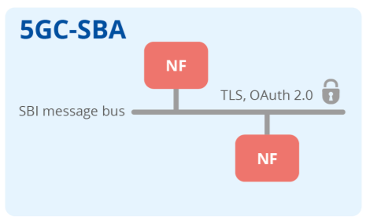
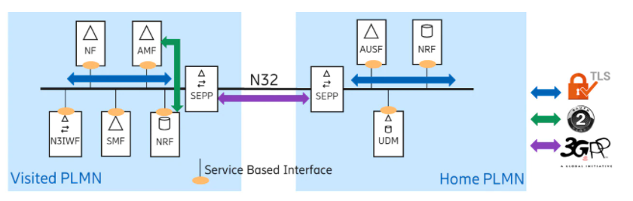
SBA domain security
The improvement provided by 3GPP SA3 to the interconnect security consists of three building blocks:
A new network function called security edge protection proxy (SEPP) was introduced in the 5G architecture. All signaling traffic across operator networks is expected to transit through these security proxies⁷
Authentication between SEPPs is required. This enables effective filtering of traffic coming from the interconnect⁷
A new application layer security solution on the N32 interface between the SEPPs was designed to provide protection of sensitive data attributes while still allowing mediation services throughout the interconnect⁷
⁷Secure communication between network functions in 5G core SBA
⁸ Service-based architecture for the 5G system in the roaming case

Slide 9
ENISA good security practices based on Release 16 from 3GPP
1. Ensure that UEs by default encrypts subscriber identifier SUPI to derive SUCI, utilizing a non-null protection scheme and the home network public key securely provided by the home network. Ensure that there is no transmitting of subscriber identifier in clear text over the access network.⁷
2. To protect data from interception and alteration, apply by default a strong, not-NULL ciphering and integrity protection algorithms for both user and signalling data exchanged between the UE and the network.⁷
3.Use a secure protocol on network or transport layer (IPSec or DTLS) to implement confidentiality, integrity and replay protection by default for both user and control plane data on RAN interfaces.⁷
4.Apply state-of-the-art mechanisms for transport protection and mutual authentication (e.g. TLS 1.2 or 1.3 with X.509 certificates), and for authorization (e.g. OAuth 2.0) between SBA network functions, by default.⁷
5.Implement authentication framework defined in the specifications, consider use of EAP for secondary authentication whenever secure authentication and authorization with external networks is required.⁷
6.Ensure correct implementation of specification requirements for end-to-end core network interconnection security, including the usage of identified state-of-the-art security protocols for transport (TLS) or application layer security (PRINS) between SEPPs in different networks and ensure appropriate procedures for key and certificate management.⁷
7.Ensure that secure, tamper resistant hardware is used for storing and/or processing of security critical data (e.g. subscriber credential and decryption keys), such as UICC (Universal Integrated Circuit Card) in UE or HSM.⁷
8. Network components and equipment should be subjected to rigorous security testing.⁷
9. Product development should ensure that mandatory and optional security features are built-in, using a robust, mature and secure product development process built with security and resilience in mind.⁷
10. Network design, configuration and deployment shall follow security best practices⁷

Slide 10




Thank you for the attention!
Questions?

Slide 11
Bibliography
¹ https://www.3gpp.org/about-3gpp/about-3gpp
² https://www.etsi.org/deliver/etsi_ts/133500_133599/133501/16.03.00_60/ts_133501v160300p.pdf
³https://www.techplayon.com/5g-authentication-and-key-management-aka-procedure/
⁴https://www.etsi.org/deliver/etsi_ts/133200_133299/133210/16.04.00_60/ts_133210v160400p.pdf
⁵https://www.etsi.org/deliver/etsi_ts/133500_133599/133501/16.03.00_60/ts_133501v160300p.pdf
⁶https://www.ericsson.com/en/blog/2019/7/3gpp-5g-security-overview
⁷ https://www.enisa.europa.eu/publications/security-in-5g-specifications

